Slide 1
Engineering direction

Slide 2
3 principles 2 goals

Slide 3
All on the guidebook

Slide 4
Engineering principles
Aspirations, not requirements

Slide 5
Principle 1: Make it work

Slide 6
1. Make it work
Engineers help people accomplish their goals with code.
Cut scope and do less
Do one thing well
Choose boring technology
Don’t dismiss

Slide 7
Principle 2: Engineer for inclusion

Slide 8
3. Engineer for inclusion
Engineering is already hard. We don’t need to make it harder.
Avoid solutions that feel like magic
Be open by default
Abstractions should increase understanding
Learn in the open
Notes:
By making information open, we can reduce the threshold to contribution and make collaboration easier.

Slide 9
Principle 3: Think like a designer

Slide 10
3. Think like a designer
Design thinking is a superpower for engineers.
Start with the problem
Focus on the interface
There is no such thing as user error
Prototype and then throw away

Slide 11
Engineering goals
Areas of growth for the year

Slide 12
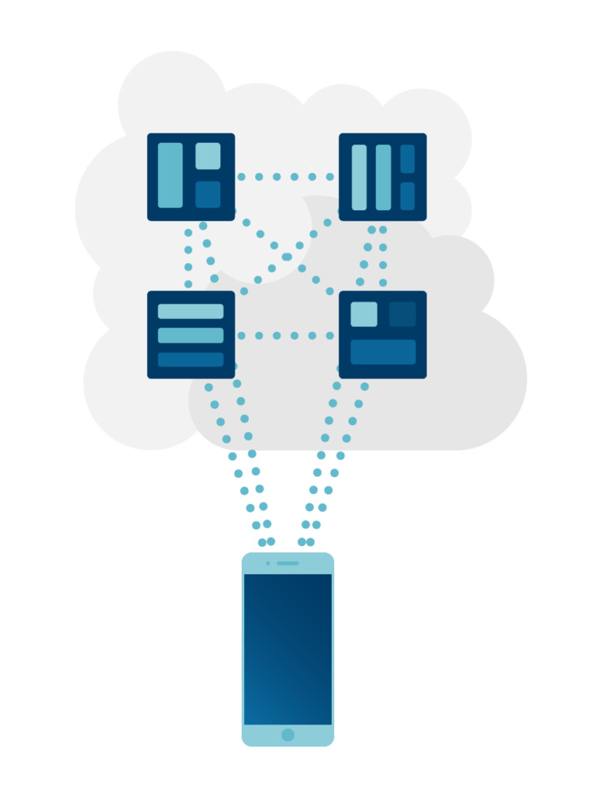
Solving problems of growth, revisited
November 2021 Digital Product Forum:
Solutions that fit the problem(s) of today
Monoliths → components + composition
Principles of system thinking
Automation
Migrations

Slide 13
“Simplest access to the best content.”

Slide 14


Engineering goals for simplifying access
Use migrations to remove barriers to access created by complexity and technical debt.
Use automation to capture lost velocity and deliver access more quickly.

Slide 15
Migrations
“The sole scalable fix to technical debt”
Notes:
Source: Will Larsen, https://lethain.com/migrations/

Slide 16
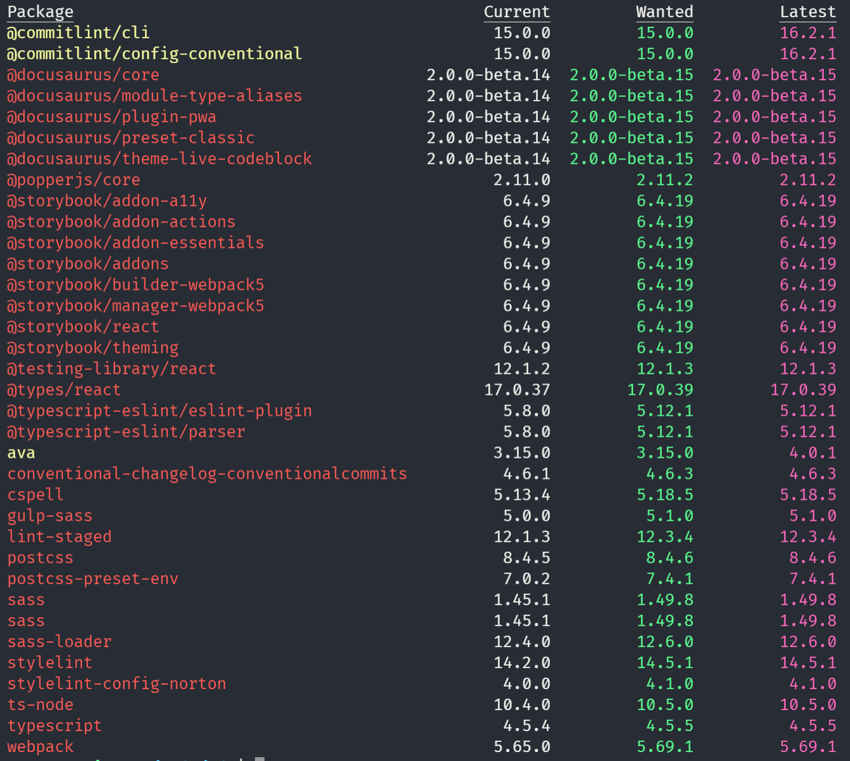



Complexity and technical debt
Some debt is good
Payments are due regularly
Interest accrues over time
Notes:
Last updated Dec 21, 2021

Slide 17
The life of technical debt
Creating new value
Maintaining technical debt
Notes:
Source/inspiration: https://lethain.com/migrations/

Slide 18
What to avoid
Drowning in technical debt

Slide 19
Paying down debt with migrations
Migrating

Slide 20
Characteristics of a successful migration
Methodically de-risk 🦺
Rebuild or rearchitect 🏗
Help teams make the switch 🤝
Shut down the old system ☠
Notes:
Derisk:
Write design document
Workshop it with edge cases; include everyone
Iterate
Focus on the most difficult migration first

Slide 21
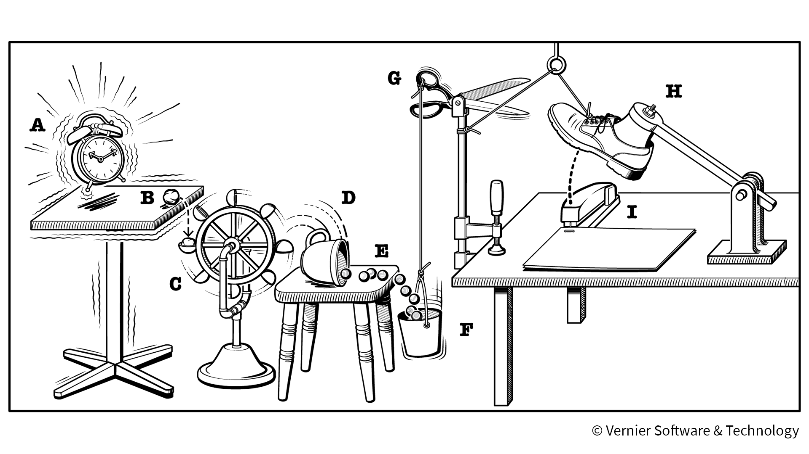
Automation
How to capture lost velocity

Slide 22
Automate to fail fast.

Slide 23
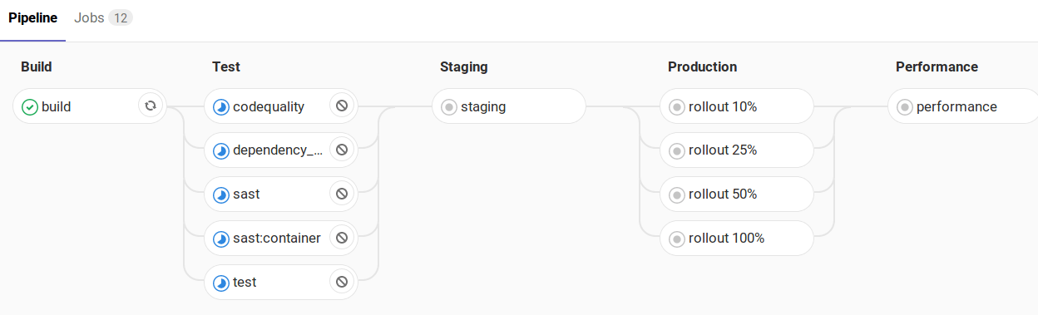
Automated deployment with CI/CD
Continuous Integration / Continuous Delivery

Slide 24
Greater confidence.

Slide 25
Better visibility.

Slide 26
More time to engineer and deliver value.

Slide 27
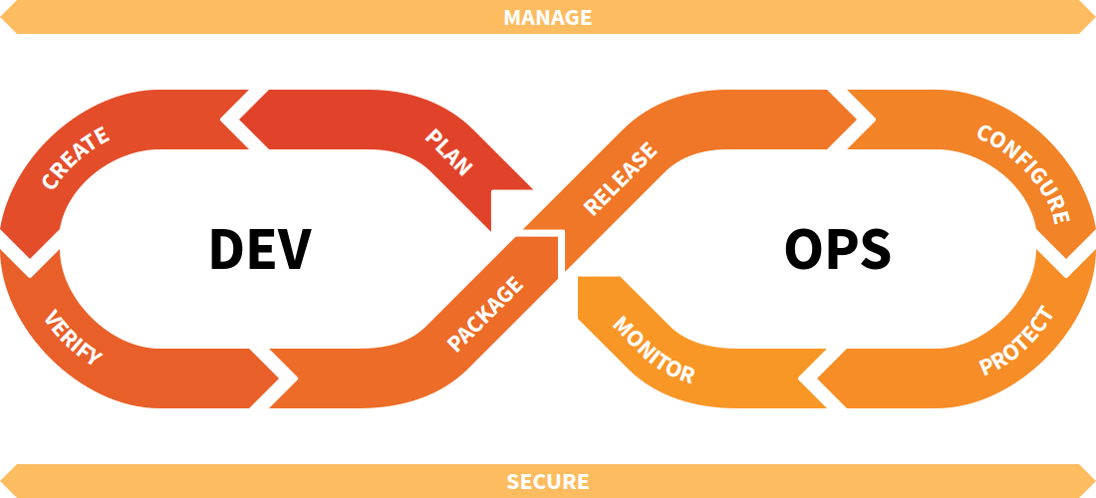
The DevOps lifecycle

Slide 28
Thank you!

